Slide 1
EXCEPTION HANDLING
Instructor:

Slide 2
Table of contents
Java Exception
Exception Handling
Checked And Unchecked Exception
Throw and throws keywords
Common Scenarios of Java Exceptions

Slide 3
Learning Approach
Strongly suggested for a better learning and understanding of this course:
Noting down the key concepts in the class
Analyze all the examples / code snippets provided
Study and understand the self study topics
Completion and submission of all the assignments, on time
Completion of the self review questions in the lab guide
Study and understand all the artifacts
Completion of the project on time inclusive of individual and group activities
Notes:
The following are strongly suggested for a better learning and understanding of this course:
Noting down the key concepts in the class
Analyze all the examples / code snippets provided
Study and understand the self study topics
Completion and submission of all the assignments, on time
Completion of the self review questions in the lab guide
Study and understand all the artifacts including the reference materials / e-learning / supplementary materials specified
Completion of the project (if application for this course) on time inclusive of individual and group activities
Taking part in the self assessment activities
Participation in the doubt clearing Sections

Slide 4
Java Exceptions
Section 1

Slide 5
Introduction Exception
During the execution of a program, the computer will face the some of situations:
syntax error
logic algorithm error
runtime error
An exception is an abnormal condition that arises^{[xuất hiện]} in a code sequence at run time.
an exception is a run-time error
Java’s exception handling avoids the problems in the run-time.
Notes:
In computer languages that do not support exception handling, errors must be checked and handled manually—typically through the use of error codes, and so on. This approach is as cumbersome as it is troublesome.

Slide 6
Introduction Exception
The Exception Handling in Java is one of the powerful mechanism to handle the runtime errors so that normal flow of the application can be maintained.
Exception is an abnormal condition.
Advantage of Exception Handling
The core advantage of exception handling is to maintain the normal flow of the application. An exception normally disrupts the normal flow of the application that is why we use exception handling.
Example:
statement 1;
statement 2;
statement 3;
statement 4;
statement 5;//exception occurs
statement 6;
statement 7;
statement 8;
statement 9;
statement 10;

Slide 7
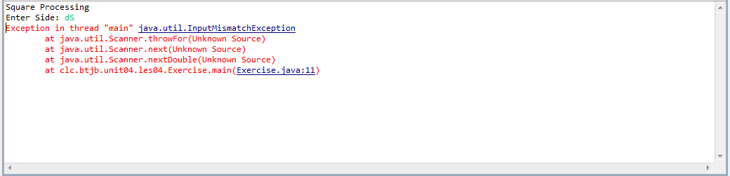
Example 1
A program that requests a number from the user:
public class Exercise {
public static void main(String[] args) {
double side;
Scanner scnr = new Scanner(System.in);
System.out.println("Square Processing");
System.out.print("Enter Side: ");
side = scnr.nextDouble();
System.out.println("\nSquare Characteristics");
System.out.printf("Side: %.2f\n", side);
System.out.printf("Perimeter: %.2f\n", side * 4);
}
}

Slide 8
Introduction Exception
Runtime errors can be divided into low-level errors that involve violating constraints, such as:
dereference of a null pointer
out-of-bounds array access
divide by zero
attempt to open a non-existent file for reading
bad cast (e.g., casting an Object that is actually a Boolean to Integer)

Slide 9
Introduction Exception
and higher-level, logical errors, such as violations of a function's precondition:
call to Stack's "pop" method for an empty stack
call to "factorial" function with a negative number
call to List's nextElement method when hasMoreElements is false
Example 2:
public class Lowlevel_Exception {
public static void main(String[] args) {
int x = 0, z = 5;
int j = 3;
int y = z / x; // Exception: Divide By Zero
int[] ar = new int[j];// Exception: Index Out Of Range
ar[j] = 5;
// suppose that a.txt does not exist
BufferedReader input = new BufferedReader(
new FileReader("a.txt"));
// Exception: File Not Found
}
}

Slide 10
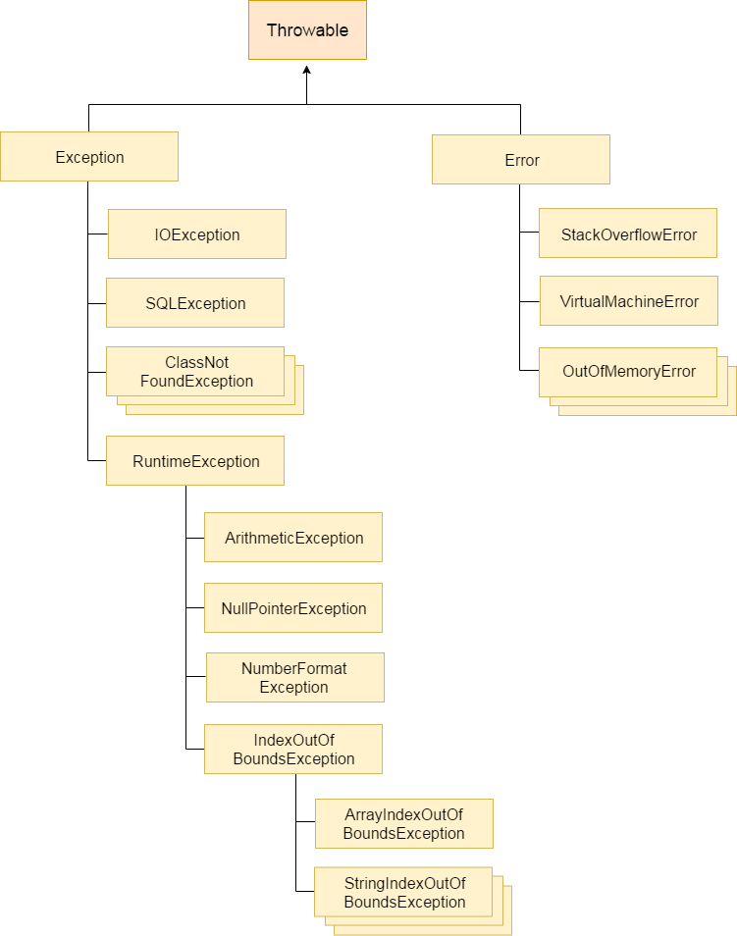
Hierarchy of Java Exception classes
The java.lang.Throwable class is the root class of Java Exception hierarchy which is inherited by two subclasses: Exception and Error.
A hierarchy of Java Exception classes are given below:

Slide 11
Types of Java Exceptions
There are mainly two types of exceptions: checked and unchecked.
Here, an error is considered as the unchecked exception.
According to Oracle, there are three types of exceptions:
Checked Exception
Unchecked Exception
Error
Exception Keywords
Keyword | Description
try | The "try" keyword is used to specify a block where we should place exception code. The try block must be followed by either catch or finally. It means, we can't use try block alone.
catch | The "catch" block is used to handle the exception. It must be preceded by try block which means we can't use catch block alone. It can be followed by finally block later.
finally | The "finally" block is used to execute the important code of the program. It is executed whether an exception is handled or not.
throw | The "throw" keyword is used to throw an exception.
throws | The "throws" keyword is used to declare exceptions. It doesn't throw an exception. It specifies that there may occur an exception in the method. It is always used with method signature.
Notes:
Checked exception là những lỗi mà compiler bắt khi viết code và JVM bắt fix khi đang code.

Slide 12
Exception handling
Section 2

Slide 13
Exception handling
When an exceptional condition arises, an object representing that exception is created and thrown in the method that caused the error.
Java exception handling is managed via five keywords: try, catch, throw, throws, and finally.
Program statements that you want to monitor for exceptions are contained within a try block.
Your code can catch this exception (using catch) and handle it in some rational manner.
To manually throw an exception, use the keyword throw. Any exception that is thrown out of a method must be specified as such by a throws clause. Any code that absolutely must be executed before a method returns is put in a finally block.

Slide 14
Exception handling
Syntax of Java try-catch
Syntax of try-finally block
Syntax of try-catch-finally block
try{
//code that may throw an exception
}catch(Exception_Class_Name ref){}
try{
//code that may throw an exception
} finally {}
try{
//code that may throw an exception
} catch(Exception_Class_Name ref){
} finally {}

Slide 15
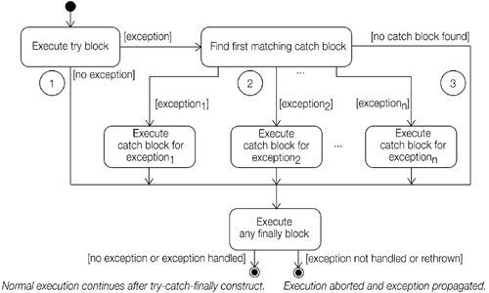
Exception handling

Slide 16
Solution for Example 1
Solution ex1:
try {
side = scnr.nextDouble();
System.out.println("\nSquare Characteristics");
System.out.printf("Side: %.2f\n", side);
System.out.printf("Perimeter: %.2f\n", side * 4);
}
catch(InputMismatchException ex) {
System.out.println(ex.getMessage());
// method get message
}

Slide 17
Solition for Example 2
Solution ex2:
public static void main(String[] args) {
int x = 0, z = 5;
int j = 3;
int[] ar = new int[j];
try {
int y = z / x;
ar[j] = 5;
BufferedReader input = new BufferedReader(new FileReader("a.txt"));
} catch (Exception ex) {
ex.getStackTrace();
// Exception Method Call Stack Trace
}
}

Slide 18
Multi-catch block
A try block can be followed by one or more catch blocks.
Each catch block must contain a different exception handler.
You have to perform different tasks at the occurrence of different exceptions, use java multi-catch block.
Points to remember:
At a time only one exception occurs and at a time only one catch block is executed.
All catch blocks must be ordered from most specific to most general, i.e. catch for ArithmeticException must come before catch for Exception.
try {
// block of code to monitor for errors
}
catch (ExceptionType1 exOb) {
// exception handler for ExceptionType1
}
catch (ExceptionType2 exOb) {
// exception handler for ExceptionType2
}
// ...
Notes:
Here, ExceptionType is the type of exception that has occurred. The remainder of this chapter describes how to apply this framework

Slide 19
Exception handling
Solution ex2:
} catch (ArithmeticException ex1) {
System.out.println(ex1.getStackTrace());
}
catch(ArrayIndexOutOfBoundsException ex2)
{
System.out.println(ex2.getStackTrace());
}
catch(FileNotFoundException ex3)
{
System.out.println(ex3.getStackTrace());
}

Slide 20
Multi-catch block
In this example, try block contains two exceptions.
But at a time only one exception occurs and its corresponding catch block is invoked.
public class MultipleCatchBlock {
public static void main(String[] args) {
try {
int a[] = new int[5];
a[5] = 30 / 0;
System.out.println(a[10]);
} catch (ArithmeticException e) {
System.out.println("Arithmetic Exception occurs");
} catch (ArrayIndexOutOfBoundsException e) {
System.out.println("ArrayIndexOutOfBounds Exception occurs");
} catch (Exception e) {
System.out.println("Parent Exception occurs");
}
System.out.println("rest of the code");
}
}
Output:
Arithmetic Exception occurs
rest of the code

Slide 21
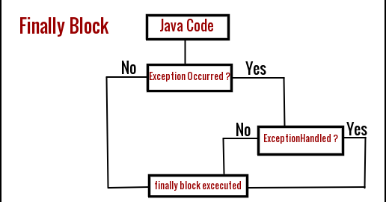
finally block
Java finally block is a block that is used to execute important code such as closing connection, stream etc.
Java finally block is always executed whether exception is handled or not.
Java finally block follows try or catch block.
Example:
Connection conn= null;
try {
conn= get the db conn;
//do some DML/DDL
} catch(SQLException ex) {
} finally {
conn.close();
}

Slide 22
Difference between final, finally and finalize
final | finally | finalize
Final is used to apply restrictions on class, method and variable Final class can't be inherited Final method can't be overridden Final variable value can't be changed. | Finally is used to place important code, it will be executed whether exception is handled or not. | Finalize is used to perform clean up processing just before object is garbage collected.
Final is a keyword. | Finally is a block. | Finalize is a method.

Slide 23
CHECKED AND UNCHECKED EXCEPTION
Section 3

Slide 24
Checked vs Unchecked exceptions
Checked exceptions
All exceptions other than Runtime Exceptions are known as Checked exceptions as the compiler checks them during compilation to see whether the programmer has handled them or not.
If these exceptions are not handled/declared in the program, it will give compilation error.
Examples of Checked Exceptions:
ClassNotFoundException
IllegalAccessException
NoSuchFieldException
EOFException, etc.

Slide 25
Checked vs Unchecked exceptions (cont.)
Unchecked Exceptions
Runtime Exceptions are also known as Unchecked Exceptions as the compiler do not check whether the programmer has handled them or not but it’s the duty of the programmer to handle these exceptions and provide a safe exit.
If these exceptions are not handled/declared in the program, it will not give compilation error.
Examples of UnChecked Exceptions:
ArithmeticException
ArrayIndexOutOfBoundsException
NullPointerException
NegativeArraySizeException, etc.

Slide 26
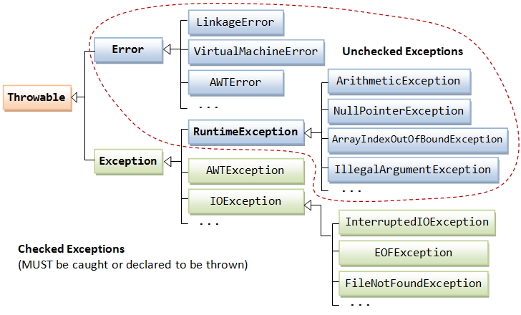
Exception classes
The figure ‎below shows the hierarchy of the Exception classes.
The base class for all Exception objects is: java.lang.Throwable, java.lang.Exception and java.lang.Error.

Slide 27
Throw and throws
Section 4

Slide 28
throw keyword
The Java throw keyword is used to explicitly throw an exception.
We can throw either checked or uncheked exception in java by throw keyword.
The throw keyword is mainly used to throw custom exception.
Syntax:
Example:
throw exception;
throw new IOException("sorry device error);
public static void isAge(int age) {
if (age < 18) {
throw new ArithmeticException("Not valid");
} else {
System.out.println("welcome to vote");
}
}

Slide 29
throw keyword
public class Main {
public static void main(String[] args) {
try {
Validator.isAge(15);
} catch (Exception e) {
e.printStackTrace();
}
}
}
Output:
java.lang.ArithmeticException: Not valid
at fa.training.utils.Validator.isAge(Validator.java:20)
at fa.training.jpe2.Main.main(Main.java:9)

Slide 30
throws keyword
The Java throws keyword is used to declare an exception.
It gives an information to the programmer that there may occur an exception so it is better for the programmer to provide the exception handling code so that normal flow can be maintained.
Exception Handling is mainly used to handle the checked exceptions.
Because:
unchecked Exception: under your control so correct your code. If there occurs any unchecked exception such as NullPointerException, it is programmers fault that he is not performing check up before the code being used
error: beyond your control e.g. you are unable to do anything if there occurs VirtualMachineError or StackOverflowError.
Syntax:
return_type method_name() throws Exception_Class_Name {
//method code
}

Slide 31
Using Throws and Throw Statements
Ex 3: Imagine you have been assigned a task of finding a specific book, and then reading and explaining its contents to a class of students. The required sequence may look like:
Get the specified book
Read aloud its contents
Explain the contents to a class of students.
Proplem: But what happens if you can't find the specified book? You can't proceed with the rest of the action without it so you need to report back to the person who assigned the task to you. This unexpected event (missing book) prevents you from completing your task. By reporting it back, you want the originator of this request to take corrective or alternate steps.

Slide 32
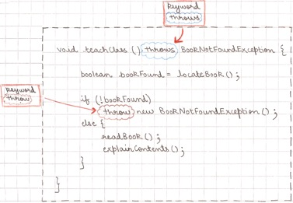
Using throws and throw
Solution:

Slide 33
Using throws and throw
Creating a method that throws a checked exception
public void readBook(String file) throws FileNotFoundException {//#1
boolean found = findFile(file);
if (!found)
throw new FileNotFoundException("Missing file"); //#2
else {
//code to read file
}
}
Public boolean findFile(String file) {
// code to return true if file can be located
}

Slide 34
Using throws and throw
In which:
#1: The throws statement indicates that this method can throw FileNotFoundException
#2: If file can't be found, code creates and throws an object of FileNotFoundException by using the throw statement
A method can include names of multiple, comma separated names in its throws statement
Using a method that throws a checked exception
When you use a method that throws a checked exception
Enclose the code within a try block and catch the thrown exception.
Declare the exception to be rethrown in the method's signature.
Implement both the above together.

Slide 35
Using throws and throw
Enclose the code within a try block and catch the thrown exception:
Declare the exception to be rethrown in the method's signature:
void useReadFile(String name) {
try {
readBook(name);
} catch (FileNotFoundException e) {
// code
}
}
void useReadFile(String name) throws FileNotFoundException {
readBook(name);
}

Slide 36
Using throws and throw
Implement both the above together:
void useReadFile(String name) throws FileNotFoundException {
try {
readBook(name);
} catch (FileNotFoundException e) {
// code
}
}

Slide 37
Difference between throw and throws
throw | throws
Java throw keyword is used to explicitly throw an exception. | Java throws keyword is used to declare an exception.
Checked exception cannot be propagated using throw only. | Checked exception can be propagated with throws.
Throw is followed by an instance. | Throws is followed by class.
Throw is used within the method. | Throws is used with the method signature.
You cannot throw multiple exceptions. | You can declare multiple exceptions e.g. public void method()throws IOException,SQLException.

Slide 38
Common Scenarios of Java Exceptions
Section 5

Slide 39
Common Scenarios of Java Exceptions
A scenario where ArithmeticException occurs
If we divide any number by zero, there occurs an ArithmeticException.
A scenario where NullPointerException occurs
If we have a null value in any variable, performing any operation on the variable throws a NullPointerException.
int a=50/0;//ArithmeticException
String s = null;
System.out.println(s.length());//NullPointerException

Slide 40
Common Scenarios of Java Exceptions
A scenario where NumberFormatException occurs
The wrong formatting of any value may occur NumberFormatException. Suppose I have a string variable that has characters, converting this variable into digit will occur NumberFormatException..
A scenario where ArrayIndexOutOfBoundsException occurs
If you are inserting any value in the wrong index, it would result in ArrayIndexOutOfBoundsException as shown below:.
String s = "abc";
int i = Integer.parseInt(s);//NumberFormatException
int a[]=new int[5];
a[10]=50; //ArrayIndexOutOfBoundsException

Slide 41
Summary
Java Exception
Exception Handling
Checked And Unchecked Exception
Throw and throws keywords
Common Scenarios of Java Exceptions

Slide 42

Thank you
42

